Slide 1
Conservation Effects on Coastal Louisiana by Ducks Unlimited
Ariel Alonso

Slide 2
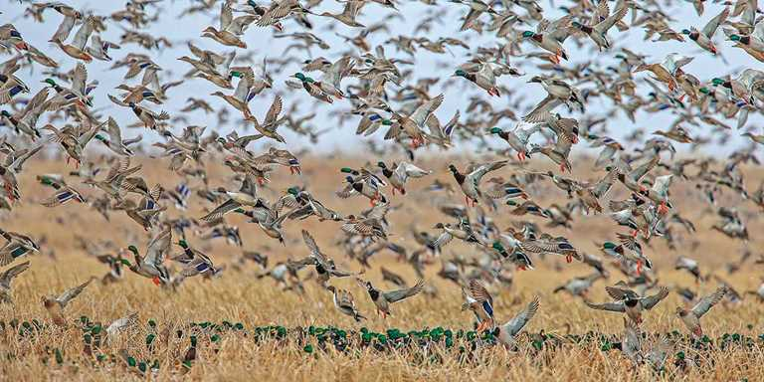
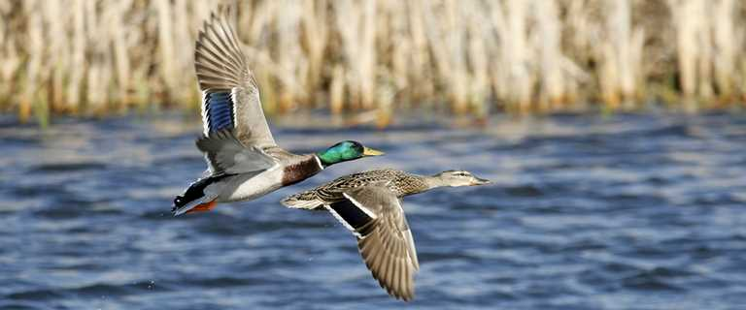
What is Ducks Unlimited?
Ducks Unlimited is a non-profit organization that focuses specifically on wetland and waterfowl conservation.
They are a volunteer-based organization with chapters located in the United States, Canada and Mexico.
They have a series of partnerships with private individuals, landowners, agencies, scientific communities, as well as other entities.

Slide 3
Ducks Unlimited Mission
“Ducks Unlimited Conserves, Restores, and Manages Wetlands and Associated Habitat for North America’s Waterfowl. These Habitats Also Benefit Other Wildlife and People.”

Slide 4
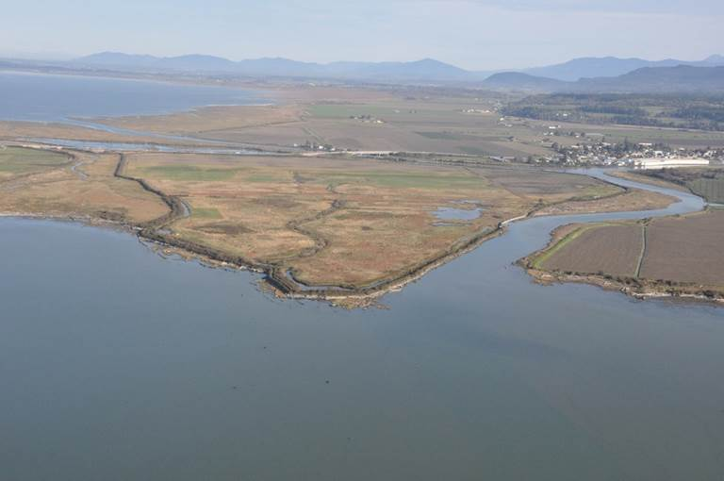
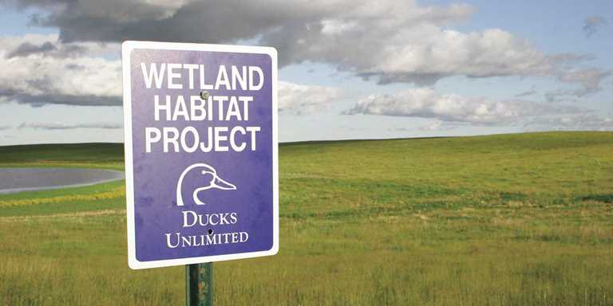
How Ducks Unlimited Conserves
Restoring grasslands
Replanting forests
Restoring watersheds
Working with landowners
Working with partners
Acquiring land
Conservation easements
Management agreements
Geographic Information Systems

Slide 5
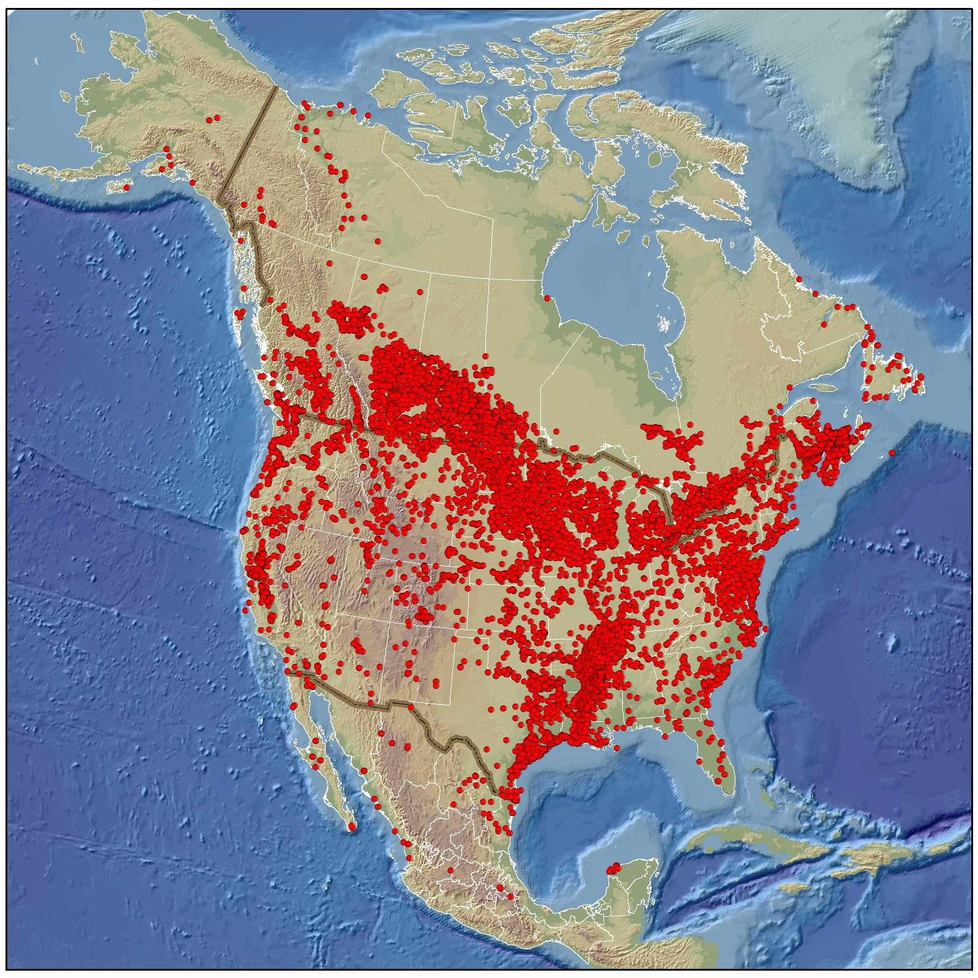
Many factors are included in their conservation of habitat such as restoration, development, enhancement, and management (Melinchuk 1995)
This conservation not only benefits waterfowl, but it also benefits other wildlife (Gildo 2002)

Slide 6
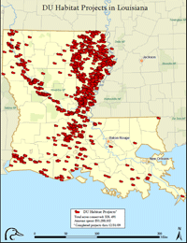
DU Conservation in Louisiana
State Project Map
DU has conserved over 497,000 acres of land in Louisiana for the waterfowl.
Not only does it benefit our waterfowl, but it also benefits our state during hurricane season and the constant coastal erosion we encounter everyday.

Slide 7
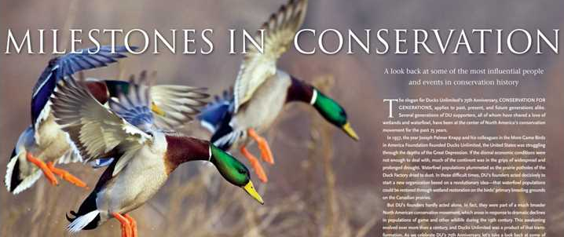
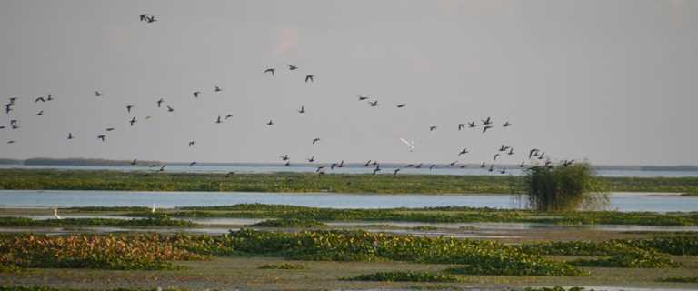
Louisiana is part of the Mississippi Flyway which provides important winter habitat for waterfowl that migrate their way south.
Our coastal marshes benefit the wintering duck population.

Slide 8
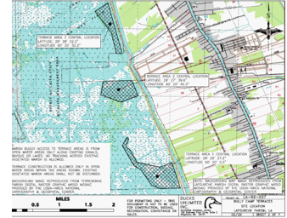
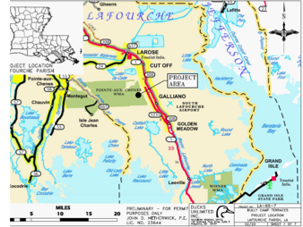
Bully Camp Terracing Project
~1,000,000 total budget to fund this project
This is one of the 53 restoration projects happening in Louisiana and scheduled to be completed for April/May 2021.
This project is specifically restoring ~35,000 linear feet of terraces some of which are adjacent to hurricane protection levee.

Slide 9
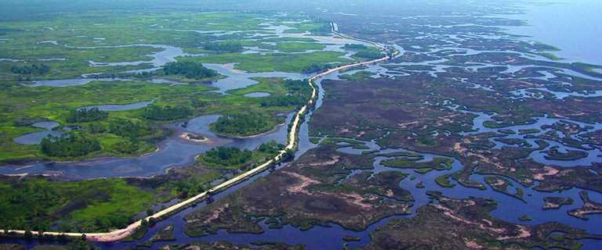
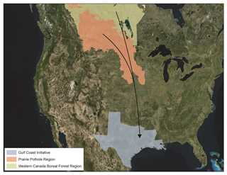
How Does This Benefit Our Coast?
The Gulf Coast has loss of over 40% of wetland habitat for its waterfowl.
Our state currently has 53 ongoing restoration projects.
Conservation work under the Gulf Coast Initiative will focus on…
  Restoration and enhancement of key public land habitats
  Protection of waterfowl habitat, which includes seasonal agricultural lands and natural and managed freshwater and intermediate marshes

Slide 10
Along with the restoration of their waterfowl habitats, Louisiana DU is also...
  Restoring near levees to protect them
  Using terraces which reduce the wave action for hurricanes
  Creating biogenic oyster shoreline system for coastal erosion
Island Road Phase II - 800 LF Biogenic Oyster Shoreline System – bioengineered cementitious coatings that are set with hatchery raised oyster larvae

Slide 11
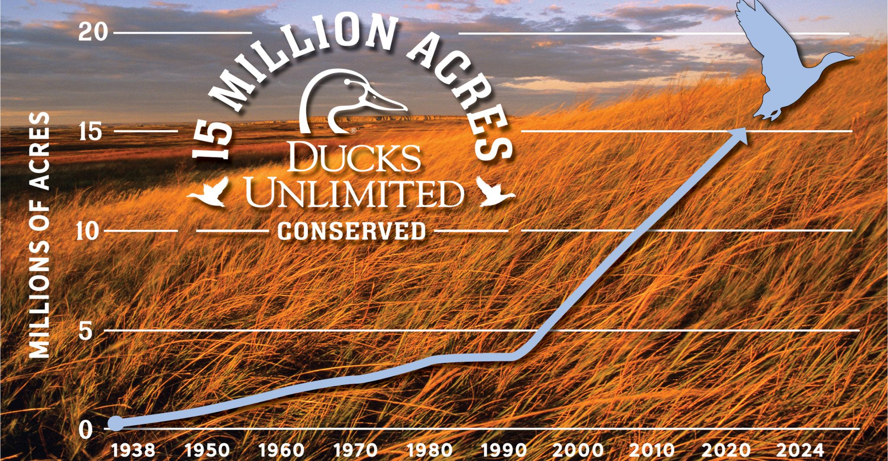
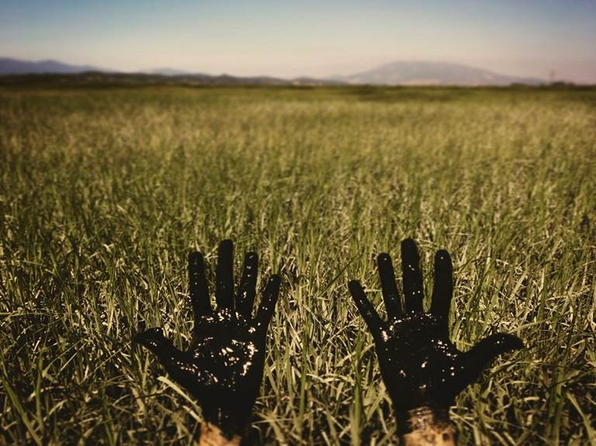
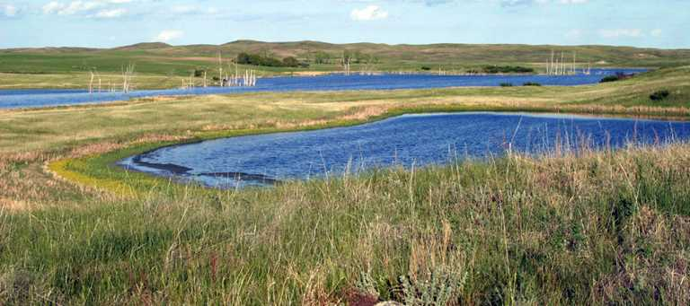
Questions?

Slide 12
Resources
Ross Melinchuk, Ducks Unlimited's landscape approach to habitat conservation, Landscape and Urban Planning, Volume 32, Issue 3, 1995, Pages 211-217, ISSN 0169-2046, https://doi.org/10.1016/0169-2046(95)07002-C.
Tori, Gildo M., et al. “Wetland Conservation and Ducks Unlimited: Real World Approaches to Multispecies Management.” Waterbirds: The International Journal of Waterbird Biology, vol. 25, 2002, pp. 115–121. JSTOR, www.jstor.org/stable/1522457. Accessed 3 May 2021.
https://www.ducks.org/About-DU?poe=adext&gclid=CjwKCAjwm7mEBhBsEiwA_of-TEc4gf38YjHa8CdQdiidhDWu4QzVP0yADI2XWGasLVRGsBMuKga-cRoCzwgQAvD_BwE&gclsrc=aw.ds
https://www.dropbox.com/scl/fi/a2smrh6ssy7yp59svmczk/Leadership-Training-2021small.pptx?dl=0&rlkey=2fyjd3x2pl5ar4kbu4pjkwsxi

